Slide 1
Consumer’s Equilibrium
Two Approaches
1. TOTAL AND MARGINAL UTILITY
Principle of diminishing marginal utility
CONSUMER EQUILIBRIUM
The consumer is said to be in equilibrium when able to spend personal income in such a way that the utility or satisfaction of the last dollar spent on the various commodities is the same. This can be expressed mathematically by:
MUx/Px= MUy/Py=MUM
subject to the constraint that
P_{x}Q_{x} + P_{y}Q_{y} + ··· = M (the individual’s income)

Slide 2

A derivation of the above equilibrium condition, in the case of two commodities (individual Income=$12, Px=$2 and Py=$1)
Q | 1 | 2 | 3 | 4 | 5 | 6 | 7 | 8
MU_{x} | 16 | 14 | 12 | 10 | 8 | 6 | 4 | 2
MU_{y} | 11 | 10 | 9 | 8 | 7 | 6 | 5 | 4
(The overall total utility received by the individual is 93 utils (obtained by adding the marginal utilities of the first 3 units of X and the first 6 units of Y in Table)

Slide 3
2. INDIFFERENCE CURVES:
DEFINITION
An indifference curve shows the various combinations of commodity X and commodity Y which yield equal utility or satisfaction to the consumer.
A higher indifference curve shows a greater amount of satisfaction and a lower one, less satisfaction.

Slide 4
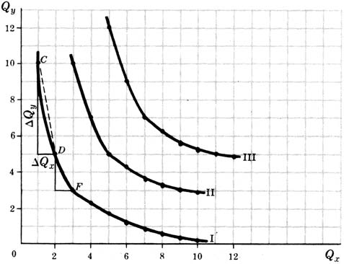
Table and Figure
Indifference Curve I |  | Indifference Curve II |  | Indifference Curve III
Q_{x} | Q_{y} | Q_{x} | Q_{y} | Q_{x} | Q_{y}
1 | 10 | 3 | 10 | 5 | 12
2 | 5 | 4 | 7 | 6 | 9
3 | 3 | 5 | 5 | 7 | 7
4 | 2.3 | 6 | 4.2 | 8 | 6.2
5 | 1.7 | 7 | 3.5 | 9 | 5.5
6 | 1.2 | 8 | 3.2 | 10 | 5.2
7 | 0.8 | 9 | 3 | 11 | 5
8 | 0.5 | 10 | 2.9 | 12 | 4.9
9 | 0.3
10 | 0.2

Slide 5
THE MARGINAL RATE OF SUBSTITUTION The marginal rate of substitution of X for Y (MRS_{xy}) refers to the amount of Y that a consumer is willing to give up in order to gain one additional unit of X (and still remain on the same indifference curve). As the individual moves down an indifference curve, the MRS_{xy} diminishes
Indifference Curve I |  |  | Indifference Curve II |  |  | Indifference Curve III
Q_{x} | Q_{y} | MRS_{xy} | Q_{x} | Q_{y} | MRS_{xy} | Q_{x} | Q_{y} | MRS_{xy}
1 | 10 | .. | 3 | 10 | .. | 5 | 12 | ..
2 | 5 | 5 | 4 | 7 | 3 | 6 | 9 | 3
3 | 3 | 2 | 5 | 5 | 2 | 7 | 7 | 2
4 | 2.3 | 0.7 | 6 | 4.2 | 0.8 | 8 | 6.2 | 0.8
5 | 1.7 | 0.6 | 7 | 3.5 | 0.7 | 9 | 5.5 | 0.7
6 | 1.2 | 0.5 | 8 | 3.2 | 0.3 | 10 | 5.2 | 0.3
7 | 0.8 | 0.4 | 9 | 3 | 0.2 | 11 | 5 | 0.2
8 | 0.5 | 0.3 | 10 | 2.9 | 0.1 | 12 | 4.9 | 0.1
9 | 0.3 | 0.2
10 | 0.2 | 0.1

Slide 6
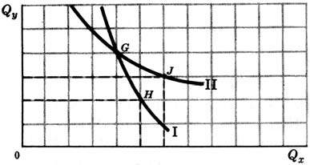
CHARACTERISTICS OF INDIFFERENCE CURVES
Indifference curves exhibit three basic characteristics:
1. They are negatively sloped,
2. They are convex to the origin, and
3. They cannot intersect

Slide 7
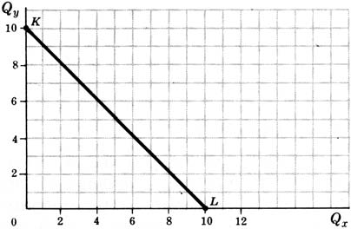
THE BUDGET CONSTRAINT LINE
The budget constraint line shows all the different combinations of the two commodities that a consumer can purchase, given his or her money income and the prices of the two commodities.
P_{x}Q_{x} + P_{y}Q_{y} = M

Slide 8
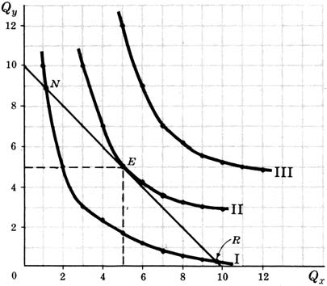
CONSUMER EQUILIBRIUM
A consumer is in equilibrium when, given personal income and price constraints, the consumer maximizes the total utility or satisfaction from his or her expenditures. In other words, a consumer is in equilibrium when, given his or her budget line, the person reaches the highest possible indifference curve.

Slide 9
The consumer would like to reach indifference curve III in Fig., but cannot because of limited income and price constraints. The individual could consume at point N or at point R on indifference curve I, but doing so would not maximize the total satisfaction from expenditures. Indifference curve II is the highest indifference curve this individual can reach with this budget constraint line.
Note that equilibrium occurs where the budget line is tangent to an indifference curve. Thus, at point E, the slope of the budget line is equal to the slope of indifference curve II

Slide 10
THE INCOME-CONSUMPTION CURVE AND THE ENGEL CURVE
By changing the consumer’s money income while keeping constant personal tastes and the prices of X and Y, we can derive the consumer’s income-consumption curve and Engel curve. The income-consumption curve is the locus of points of consumer equilibrium resulting when only the consumer’s income is varied. The Engel curve shows the amount of a commodity that the consumer would purchase per unit of time at various levels of total income.
Example.
If P_{x}=$1 and P_{y}= $1, and if the consumer’s money income (M) rises from $6 to $10 and then to $14 per time period, then the consumer’s budget lines are given, respectively, by lines 1, 2, and 3 in Fig. Thus, when M= $6, the consumer reaches equilibrium at point F on indifference curve I by purchasing 3X and 3Y. When M =$10, the consumer reaches equilibrium at point E on indifference curve II by purchasing 5X and 5Y. When M=$14, the consumer is in equilibrium at point S and purchases 7X and 7Y. By joining these points of consumer equilibrium, we get income-consumption curve FS

Slide 11
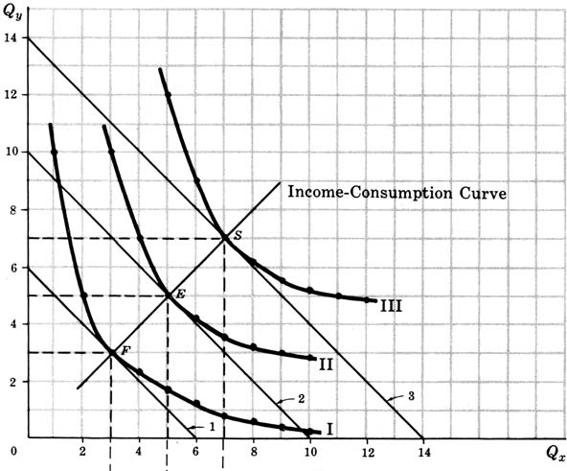
Income-Consumption Curve (ICC)

Slide 12
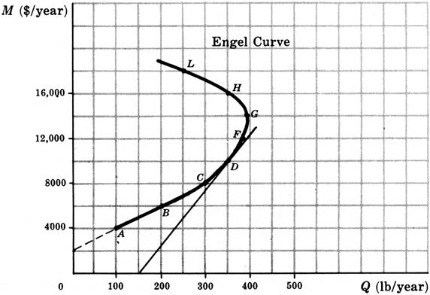
Engel Curve
The Engel curve is positively sloped, e_{M} > 0 and commodity X is a normal good.
The Engel curve is negatively sloped, e_{M} < 0 and the good is inferior.
The Engel curve is positively sloped, e_{M} >1, the commodity is a luxury at that point.
The Engel curve is positively sloped and e_{M} is between zero and 1, the commodity is a necessity
Point | A | B | C | D | F | G | H | L
Income ($/year) | 4,000 | 6,000 | 8,000 | 10,000 | 12,000 | 14,000 | 16,000 | 18,000
Quantity (lb/year) | 100 | 200 | 300 | 350 | 380 | 390 | 350 | 250

Slide 13
THE PRICE-CONSUMPTION CURVE AND THE CONSUMER’S DEMAND CURVE
By changing the price of X while keeping constant the price of Y and the consumer’s tastes and money income, we can derive the consumer’s price-consumption curve and demand curve for commodity X. The price-consumption curve for commodity X is the locus of points of consumer equilibrium resulting when only the price of X is varied. The consumer’s demand curve for commodity X shows the amount of X that the consumer would purchase at various prices of X, ceteris paribus.

Slide 14
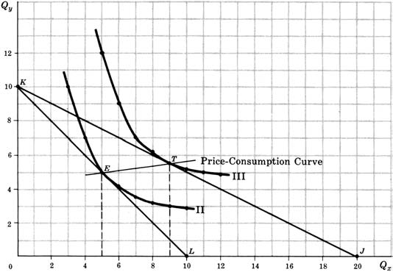
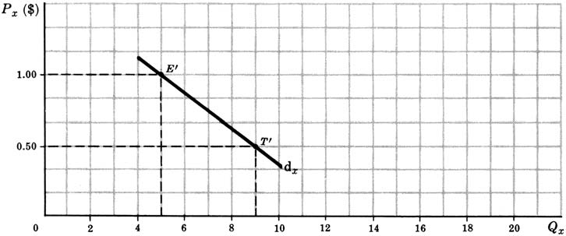
Derivation of Demand Curve

Slide 15
SEPARATION OF THE SUBSTITUTION AND INCOME EFFECTS
We can separate the income effect from the substitution effect of the price fall by reducing the consumer’s money income sufficiently to keep real income constant. This can be accomplished by shifting budget line KJ in Fig down and parallel to itself until it is tangent to indifference curve II. The movement along indifference curve II will give us the substitution effect. The total effect of the price change (ET) minus the substitution effect will give us the income effect.
Total Effect = Substitution Effect + Income Effect
ET = EG + GT

Slide 16
